Slide 1

Bosch SCD 110

Slide 2
Introduction
The SCD is a multi-sensor IoT device that measures acceleration, magnetic fields, temperature and light.
The robust housing, compact design and easy installation make it perfectly suitable for industrial retrofit applications, such as condition monitoring and predictive maintenance.
Configuring the device enables the user to address a broad variety of use cases.

Slide 3
Built-in sensors
Accelerometer
Light sensor
Magnetometer
Temperature sensor

Slide 4
User Interface
SCD sensor app
Free smartphone application for configuration, read out and visualization.

Slide 5
Communication Interface
Wireless communication
Bluetooth low energy
Range: up to 40 m (dependent on external influences)

Slide 6
Connecting to the SCD
Download the SCD Sensor App.
Activate Bluetooth on your smartphone.
To activate the SCD, press shortly the button on the device.
Start the SCD Sensor App.
After starting, the app shows a search button. Click on the search button to find devices.
Choose your SCD by tapping on your device in the list of devices to establish the connection between the SCD device and the smartphone / tablet.

Slide 7
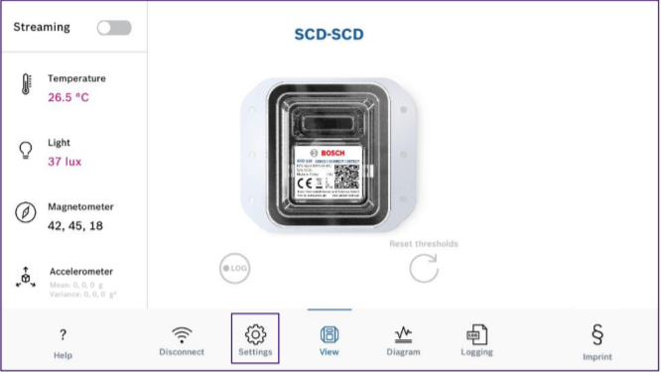
SCD App Tabs
Help: See help screens related to the area you are currently in.
Disconnect: Click on the Disconnect icon if you want to disconnect your device.
Settings: Rename your device and configure thresholds of the sensors.
View: Start / stop data streaming. See current values from the sensors.
Diagram: Show the streamed data in graphics.
Logging: Configure logging sampling rates, start / stop logging, download logging data.

Slide 8
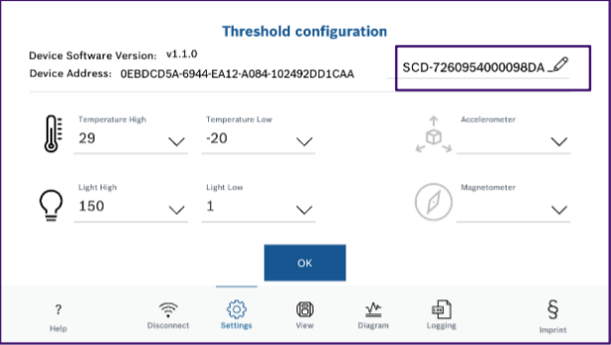
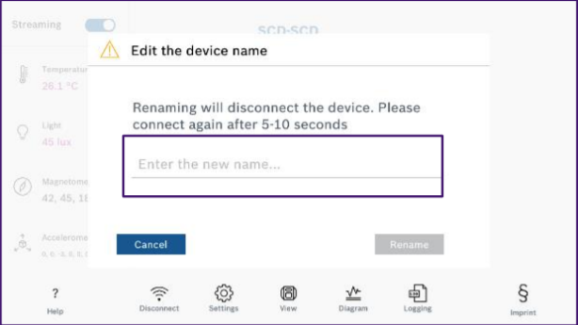
Configuring the SCD
Tap on the Settings icon.
To ensure easy identification of your devices, please rename your SCD by tapping on the pencil and typing in your preferred name.
Then tap Rename.

Slide 9
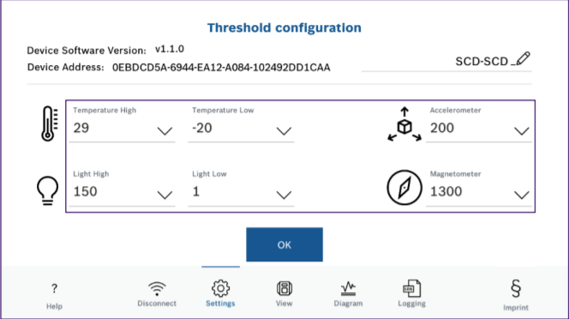
Threshold Setting
The thresholds are used for threshold monitoring in SCD. When the thresholds are violated, SCD sends an alarm via BLE.
In this case the app shows the measurement values in red colour.
Set the threshold values by tapping the Settings icon.

Slide 10
Streaming
The streaming function transmits sensor values to the app at a fixed rate. Values can be visualized and recorded in the View tab.
Tap on the streaming button to start data streaming. The data is shown under the respective sensor icon.
In case of threshold violation the values are shown in red colour. This can be re-setted with the reset thresholds button.
The Accelerometer values are shown as mean (average of ~170 values) and variance (how much it differs from the average).

Slide 11
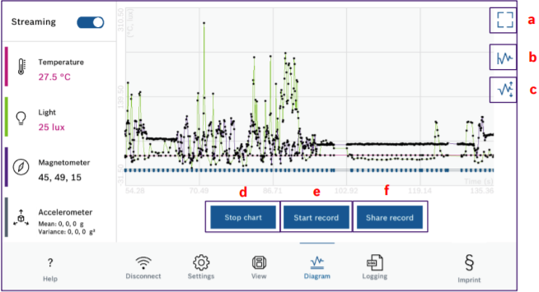
Data on the Chart
Tap on the Diagram icon.
Select the sensors you want to see in the chart by tapping the sensor icons. The graphics and values are then displayed.
Chart view options:
a. Refresh: If the user zooms in on the chart, tap on this icon to restore the original view.
b. Enable/disable scrolling in the visible window to show all X values in the graph.
c. Enable/disable auto scale of the y axis of the graph.
d. Start / stop: Tap on this button to show / freeze streaming data in the graph.
e. Starts / stops recording the streaming graph.
f. Share the CSV of the last recorded session.

Slide 12
Logging and Transferring the Data
The function stores raw data in the SCD internal memory.
The logging settings can be configured by tapping on the Logging icon.
Set the desired sampling rates for each sensor which should be used by data logging.
Leave the sensors Disabled, if you don’t want to get data from them in the log file.
Tap on Start logging.
Confirm the logging start.
The data is stored locally in SCD until the memory is full or until the logging is stopped by the user.
The data is ready to download.

Slide 13
Trouble Shooting
Problem | Solution
The app does not display any values | Check whether you have switched the streaming on and activated the sensors in the app.
The light sensor is permanently at 0 | Check if any additional label attached to the SCD. These can cover the light sensor.
The protective cover is damaged | Do not use the device.
None of the values are changing | Check whether you have switched on streaming in the app. Check if the sensor is activated.
Connection fails | Make sure you get a user dialog asking for “Pairing”. Make sure you accept pairing.
I get disconnected after a while | This can be normal. If there is no activity in the app for two minutes, the SCD will disconnect to save battery.
I used the SCD only few times but the battery is empty. | Ensure that you disconnect SCD after disabling the streaming. If you leave the streaming active. It will continue to stream data over BLE and drain the battery.

